Slide 1
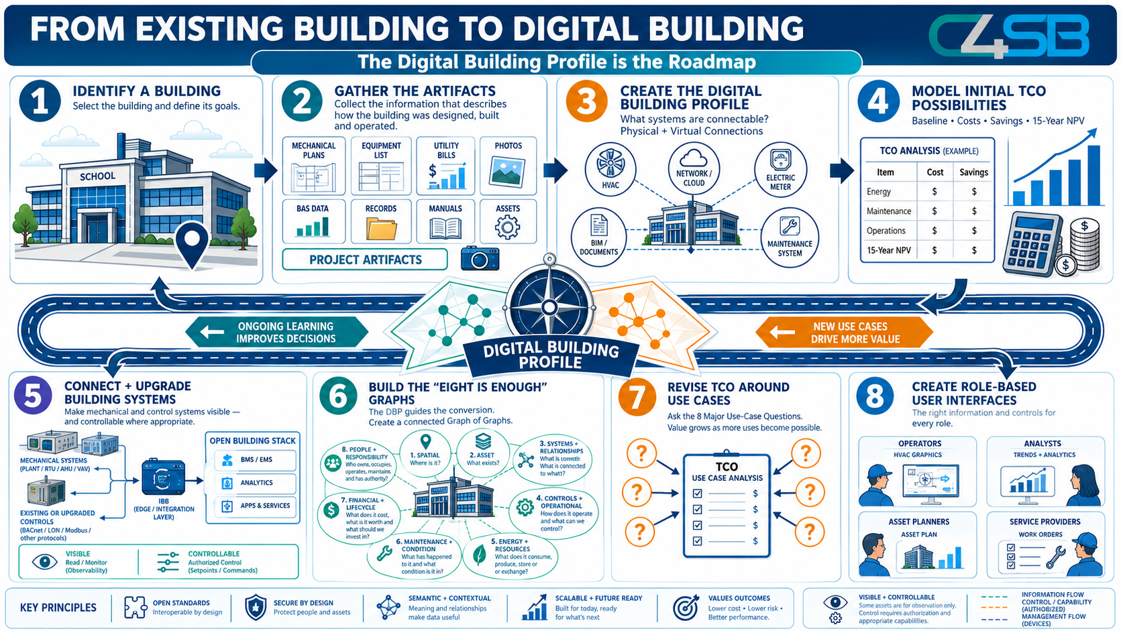
FROM EXISTING BUILDING
TO DIGITAL BUILDING
A Step-by-Step Roadmap
based on Open Standards and Resources
September 3, 2026.
Rick Justis, Executive Director
Pete Scanlon, Operations Director
Copyright © 2026 The Linux Foundation®. All rights reserved. The Linux Foundation has registered trademarks and uses trademarks. For more information, including terms of use, privacy policy, and trademark usage, please see our Policies page. Privacy Policy | Trademark Usage

Slide 2
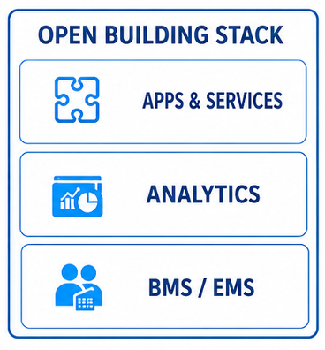
Notes:
FROM EXISTING BUILDING TO DIGITIAL BUILDING
The Digital Building Profile is the Roadmap
Most buildings were never designed to become “digital buildings.” They were designed, constructed, renovated and operated over decades using drawings, specifications, equipment schedules, control systems, maintenance records, utility bills and the accumulated knowledge of the people who operate them.
That does not mean we need to start over.
The path to a digital building begins by understanding what already exists, determining what can be connected, deciding what is worth improving, and progressively creating a digital representation of the building that can support operations, analytics, lifecycle decisions—and increasingly, AI.
The Digital Building Profile (DBP) provides the roadmap for doing that.
Illustrations are conceptual. Screen values and example addresses are illustrative, not observations from a specific facility.

Slide 3
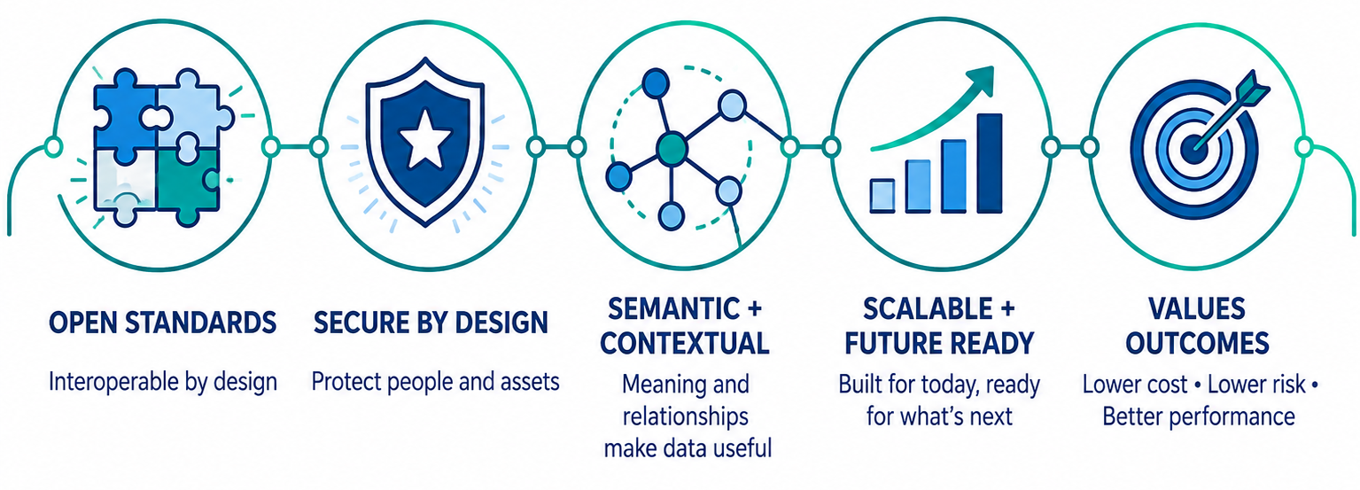
FIVE KEY PRINCIPLES
PRINCIPLES FROM THE ROADMAP
Notes:
FIVE KEY PRINCIPLES
Before we step through the steps to making an Existing Building into a Digital Building, it’s important to note that all of the work that C4SB does is guided by five key principles:
OPEN STANDARDS – Interoperable by design
SECURE BY DESIGN – Protect people and assets
SEMANTIC + CONTEXTUAL – Meaning and relationships make data useful
SCALABLE + FUTURE READY – Built for today, ready for what’s next
VALUES OUTCOMES – Lower cost • Lower risk • Better performance
The roadmap presented here, and the work of all the C4SB working and interest groups supporting it, follow these principles to the best we can at every step, helping engage like-minded contributors and produce OPEN Standards • Security • Meaning • Scalability • and Outcomes.

Slide 4
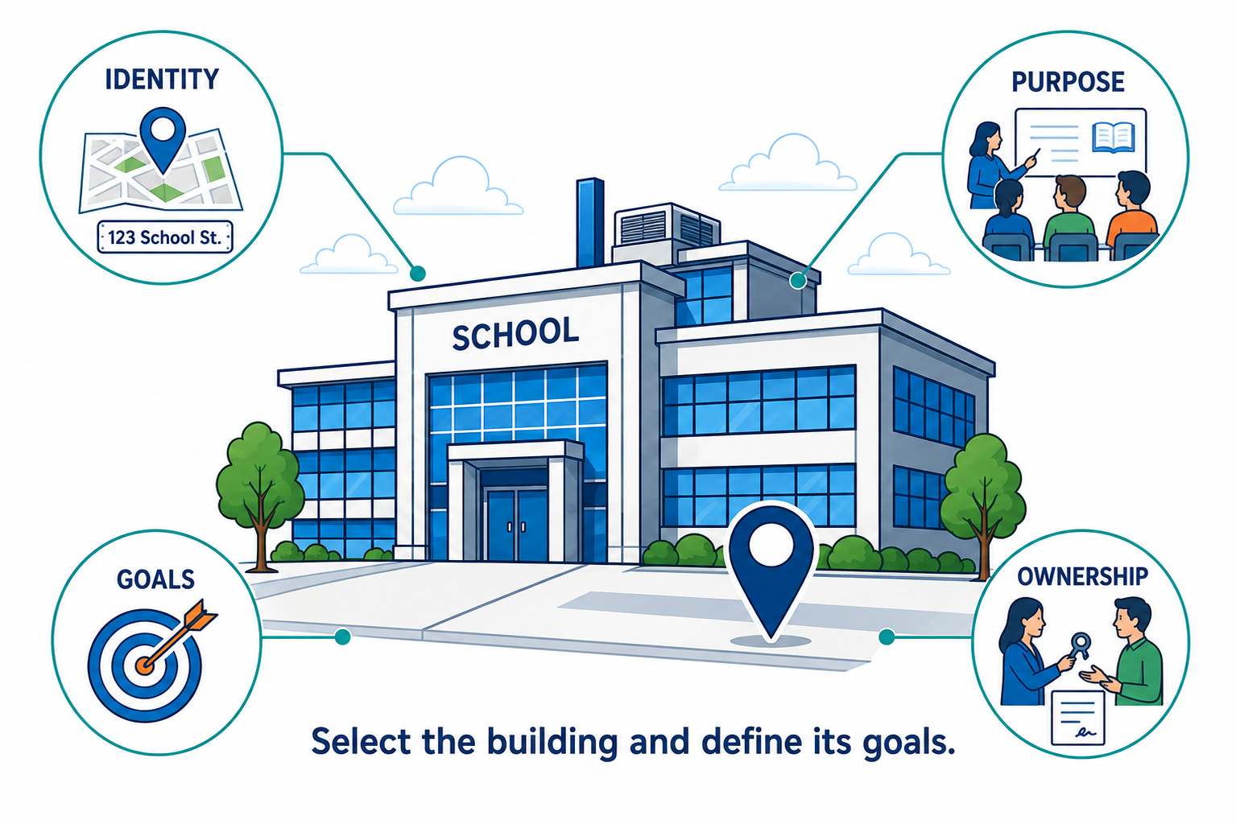
1 IDENTIFY A BUILDING
DEFINE THE STARTING POINT
Identify the place, its purpose,
its owners, and its goals.
Notes:
1. IDENTIFY A BUILDING
Where are we starting, and what are we trying to accomplish?
Every digital building starts with a physical building.
The first step is deliberately simple: Identify the building and establish the objectives for making it more digital. What is the facility? How is it used? Who owns and operates it? What problems are we trying to solve? What opportunities are we trying to create?
This matters because a digital building is not a technology product that gets installed. A school, hospital, office building, manufacturing plant and data center have very different systems, risks, economics and operational priorities.
At this stage we are establishing the boundary and purpose of the project, not prescribing the technology.
The questions begin with:
What building are we talking about? What matters about it? What do we want to be able to do that we cannot do today?
Those questions become the starting point for the Digital Building Profile.
Illustrations are conceptual. Screen values and example addresses are illustrative, not observations from a specific facility.

Slide 5
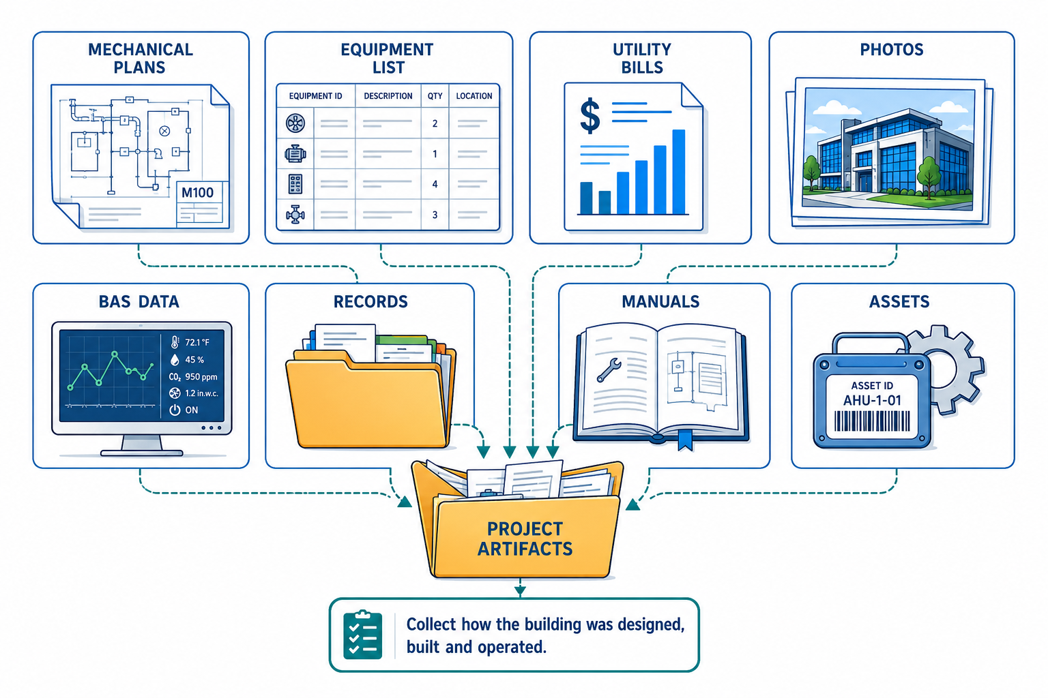
2 GATHER THE ARTIFACTS
BUILD THE EVIDENCE BASE
Bring drawings, records, data,
and observations together.
Notes:
2. GATHER THE ARTIFACTS
Bring drawings, records, data, and observations together.
What do we already know about the building?
Buildings already contain enormous amounts of information. The problem is that the information is usually scattered across documents, systems, databases, organizations and people.
Mechanical and electrical drawings tell us how systems were designed.
Equipment schedules tell us what was installed.
Controls drawings and point lists tell us how equipment was intended to operate.
BIM and CAD files describe spaces and assets.
BAS data tells us what is happening now.
Utility bills describe consumption.
Maintenance systems record what has happened over time.
Photos, manuals, commissioning reports, specifications, invoices and institutional knowledge provide still more pieces of the picture.
So before installing anything new, gather what already exists.
The objective is not simply document collection. It is to begin transforming fragmented project artifacts into structured knowledge about the building.
A surprising amount of the future digital building may already exist—we simply haven't connected the pieces yet.
Illustrations are conceptual. Screen values and example addresses are illustrative, not observations from a specific facility.

Slide 6
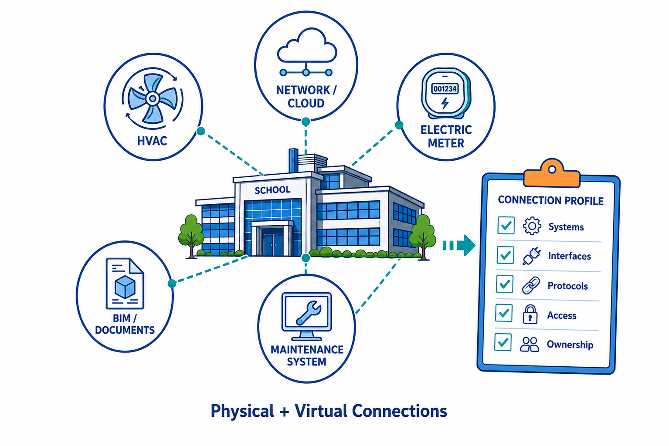
3 CREATE THE DIGITAL BUILDING PROFILE
DIGITAL BUILDING PROFILE
MAP WHAT CAN CONNECT
Identify physical systems, digital
interfaces, and access requirements.
C4SB WORKING GROUP(S)
DIGITAL BUILDING PROFILE Working Group – Collecting and publishing standards for a digital survey of a building or portfolio.
Notes:
3. CREATE THE DIGITAL BUILDING PROFILE
Identify physical systems, digital interfaces, and access requirements.
What exists, and what can connect?
Now we begin assembling those pieces into a coherent picture.
The Digital Building Profile describes the building's physical systems and its existing digital capabilities.
What HVAC systems exist? Electrical systems? Lighting? Metering? Life-safety systems? Controls? Networks? BIM? BAS? CMMS? Utility interfaces? Cloud applications?
Then comes an equally important question:
Which of these systems are already connectable?
Some equipment may already support BACnet, Modbus, LON or IP-based interfaces. Some systems may expose APIs. Some may already be connected to a BAS or supervisory platform. Others may be completely analog or effectively stranded behind proprietary interfaces.
The DBP therefore becomes both an inventory and a readiness/gap analysis.
It tells us:
What exists? What is already digital? What can communicate? What cannot? What information is available? What is missing?
Instead of beginning with a technology solution, we now have a roadmap grounded in the actual building.
Illustrations are conceptual. Screen values and example addresses are illustrative, not observations from a specific facility.

Slide 7
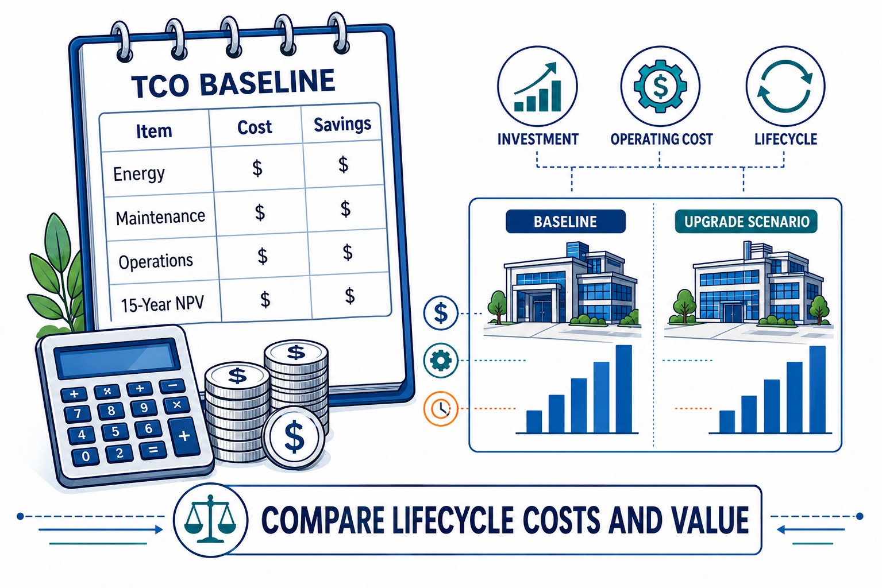
4 MODEL INITIAL TCO POSSIBILITIES
ESTABLISH THE VALUE BASELINE
Compare costs, savings, and
15-year lifecycle possibilities.
C4SB WORKING GROUP(S)
TXO – Total “X” of Ownership model for a building or portfolio. Solving for whatever “X” helps answer the question at hand.
Notes:
4. MODEL INITIAL TCO POSSIBILITIES
Compare costs, savings, and 15-year lifecycle possibilities.
Where might creating a digital building produce value?
Before upgrading everything simply because we can, we should ask whether we should.
The initial Digital Building Profile provides enough information to begin developing a Total Cost of Ownership model.
What does the building currently cost to operate? What does it consume? What equipment is approaching replacement? Where are maintenance dollars being spent? What labor is required? Where are operational problems occurring? What risks exist?
Then we can begin asking what might change if systems were better connected, observable and manageable.
Potential benefits might include energy savings, maintenance reductions, avoided equipment replacement, improved comfort, reduced operational labor, demand flexibility, increased equipment life, improved resilience or entirely new operational capabilities.
This is deliberately an initial TCO model.
We do not yet know every possible use case—and that is precisely the point.
The first model establishes a baseline against which subsequent digital investments can be evaluated.
Illustrations are conceptual. Screen values and example addresses are illustrative, not observations from a specific facility.

Slide 8
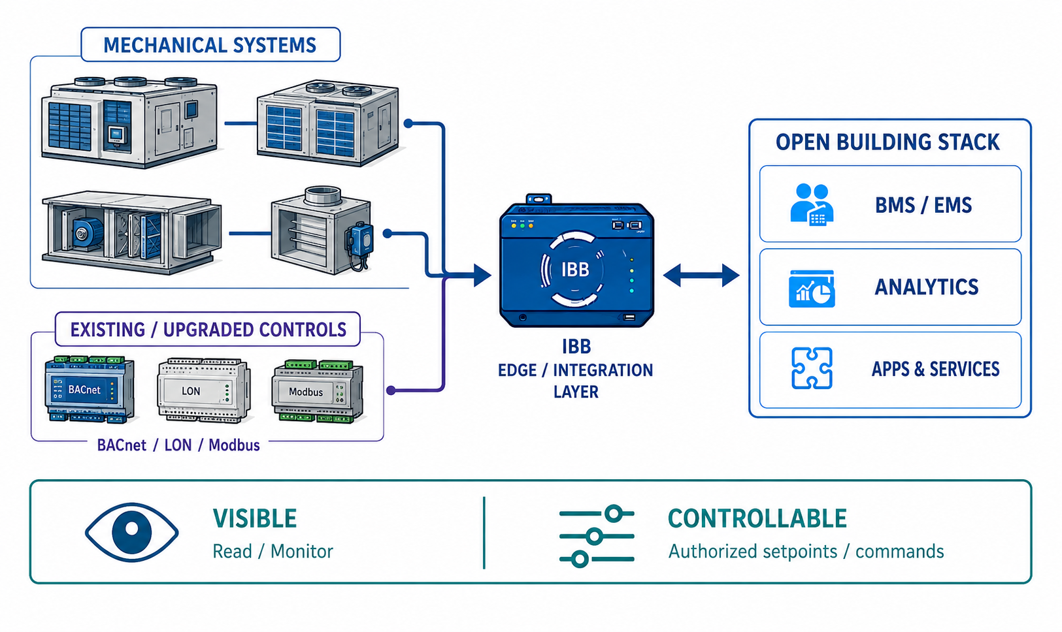
5 CONNECT + UPGRADE BUILDING SYSTEMS
CONNECT WITH PURPOSE
Make systems visible.
Enable authorized control where appropriate.
C4SB WORKING GROUP(S)
IBB – Interoperable Building Box: on-prem, multi-vendor, Linux compute environment
OPEN BUILDING STACK – Tech stack based on open, cloud native architecture and resources.
Notes:
5. CONNECT + UPGRADE BUILDING SYSTEMS
Make systems visible. Enable authorized control where appropriate.
Make systems visible—and controllable where appropriate.
This is the critical bridge between describing the building and digitally operating the building.
And importantly, it does not mean replacing every control system.
Many modern building systems are already digitally capable. Equipment may already communicate through BACnet/IP, BACnet MS/TP, Modbus, LON or other interfaces. Those systems may simply need to be securely connected and exposed to the building's interoperable infrastructure.
Other systems will require an upgrade.
A conventional thermostat-controlled rooftop unit, for example, may need a new controller and sensors. A legacy meter may require a gateway. An inaccessible piece of equipment may require additional instrumentation.
The Digital Building Profile tells us which path is appropriate:
CONNECT what is already capable. UPGRADE what needs digital capability.
Those systems can then connect through an Interoperable Building Box (IBB) and into the Open Building Stack, creating a common, open path between physical building systems and digital applications.
But there is an essential distinction:
Visible does not automatically mean controllable.
Some systems should provide observation:
Read → Monitor → Alarm → Trend → Diagnose
Others may appropriately expose authorized control capabilities:
Setpoints → Commands → Schedules → Overrides → Supervisory Control
Control must be intentional, authorized and governed.
This makes Step 5 much larger than a conventional “controls upgrade.” We are creating the operational bridge:
PHYSICAL BUILDING → CONTROLS & INTERFACES → IBB → OPEN BUILDING STACK
The physical building is becoming digitally accessible without requiring every underlying system to come from the same manufacturer, generation or technology stack.
Illustrations are conceptual. Screen values and example addresses are illustrative, not observations from a specific facility.

Slide 9
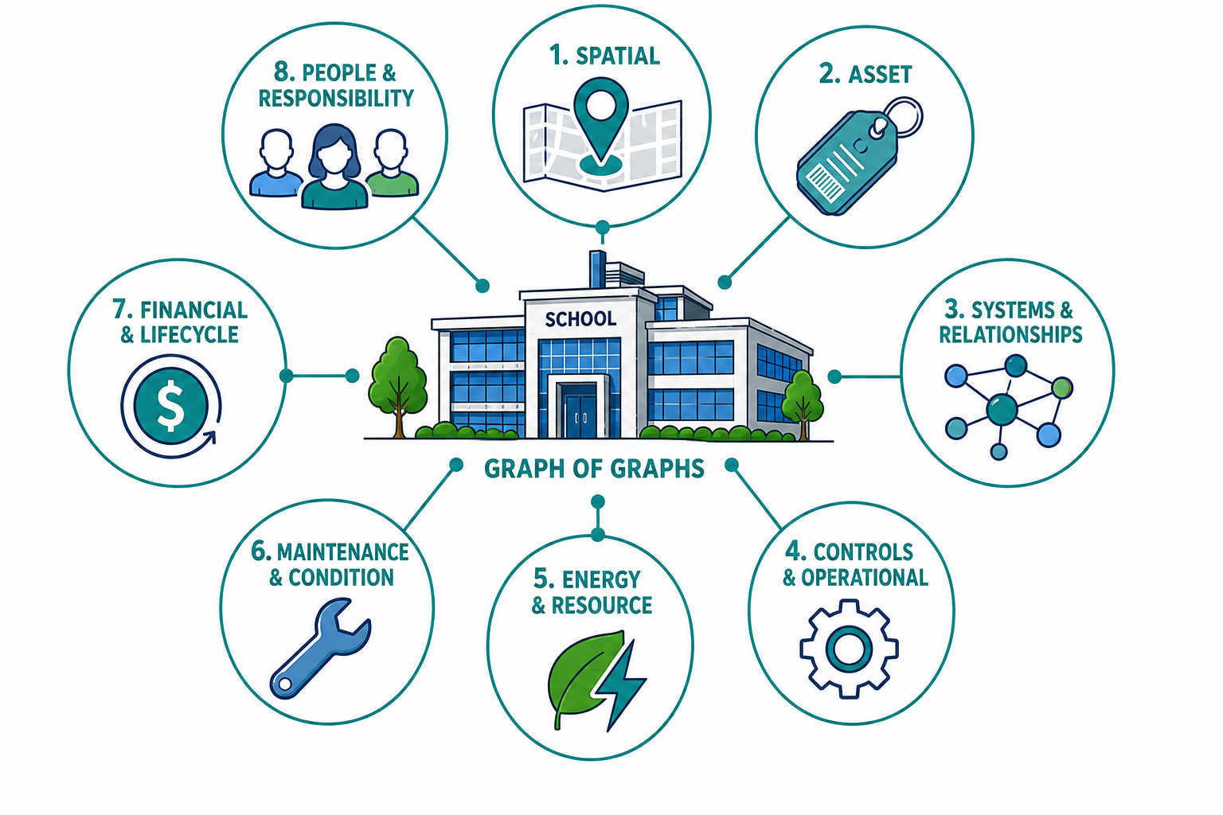
6 BUILD THE “EIGHT IS ENOUGH” GRAPHS
GIVE BUILDING DATA CONTEXT
The DBP guides conversion into
a connected Graph of Graphs.
OPEN ELEMENTS
ASHRAE 223
BRICK
REC
RDF
Notes:
6. BUILD THE “EIGHT IS ENOUGH” GRAPHS
The DBP guides conversion into a connected Graph of Graphs.
Turn building data into building knowledge.
Connectivity gives us data.
It does not necessarily give us meaning.
Knowing that a controller exposes a value called “AI-17” is useful only if we understand what “AI-17” represents, what equipment it belongs to, where that equipment is located, what system it participates in, what it serves and how it relates to everything else in the building.
This is where the Digital Building Profile evolves into a connected Graph of Graphs.
We represent the building through eight complementary perspectives:
Spatial Graph — Where is it?
Asset Graph — What exists?
Systems & Relationships Graph — What is connected to what?
Controls & Operational Graph — How does it operate, and what can we control?
Energy & Resource Graph — What does it consume, produce, store or exchange?
Maintenance & Condition Graph — What has happened to it, and what condition is it in?
Financial & Lifecycle Graph — What does it cost, what is it worth, and what should we invest in?
Organization, People & Responsibility Graph — Who owns, occupies, operates, maintains and has authority over it?
These are not eight copies of the building.
They are eight perspectives on the same physical reality.
Open standards such as ASHRAE 223, Brick, REC, RDF and related semantic technologies allow identities and relationships to connect these perspectives without forcing every application into a single monolithic data model.
Now we have moved from connected data to connected knowledge.
Illustrations are conceptual. Screen values and example addresses are illustrative, not observations from a specific facility.
Eight full graph categories: Spatial; Asset; Systems & Relationships; Controls & Operational; Energy & Resource; Maintenance & Condition; Financial & Lifecycle; Organization, People & Responsibility.

Slide 10
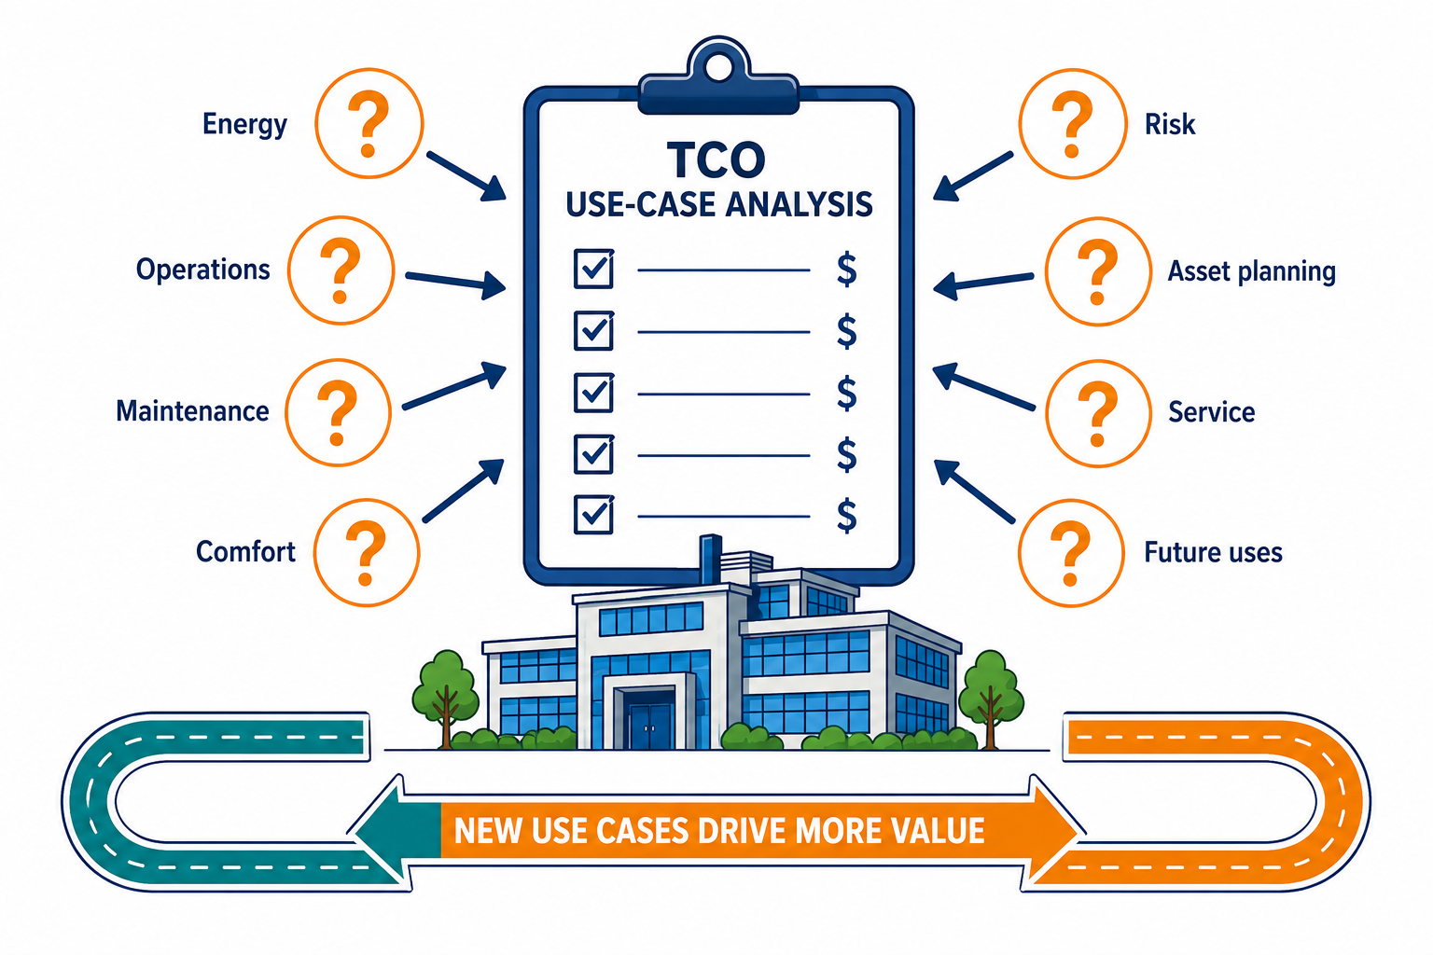
7 REVISE TCO AROUND USE CASES
TEST NEW VALUE POSSIBILITIES
Ask eight use-case questions.
Quantify the value of new uses.
C4SB WORKING GROUP(S)
TXO – Total “X” of Ownership model for a building or portfolio. Solving for whatever “X” helps answer the question at hand.
Notes:
7. REVISE TCO AROUND USE CASES
Ask eight use-case questions. Quantify the value of new uses.
What becomes possible now that the building is connected and understandable?
This is where the economics become much more interesting.
In Step 4, we estimated value based largely on what we already knew.
Now we can ask questions that previously required information scattered across multiple systems—or questions nobody anticipated when those systems were installed.
What happens if we combine energy, equipment condition and maintenance history?
What if we connect occupancy with HVAC operation?
What if replacement planning incorporates actual operating condition rather than equipment age alone?
What if an operator can understand not merely that an alarm occurred, but what equipment is affected, what spaces it serves, what other assets depend upon it, who is responsible for it and what failure costs the organization?
Each new relationship creates potential new use cases.
Each use case can have an economic value.
So we return to the TCO model.
The digital building is no longer justified by a single energy-saving application or controls project. Its value comes increasingly from the reuse of the same digital infrastructure across many use cases.
That creates a reinforcing cycle:
More knowledge → More use cases → More value → Better investment decisions → More knowledge.
Illustrations are conceptual. Screen values and example addresses are illustrative, not observations from a specific facility.
The labeled areas in the expanded illustration are examples of use-case domains. The supplied master refers to eight major use-case questions without supplying the canonical question wording.

Slide 11
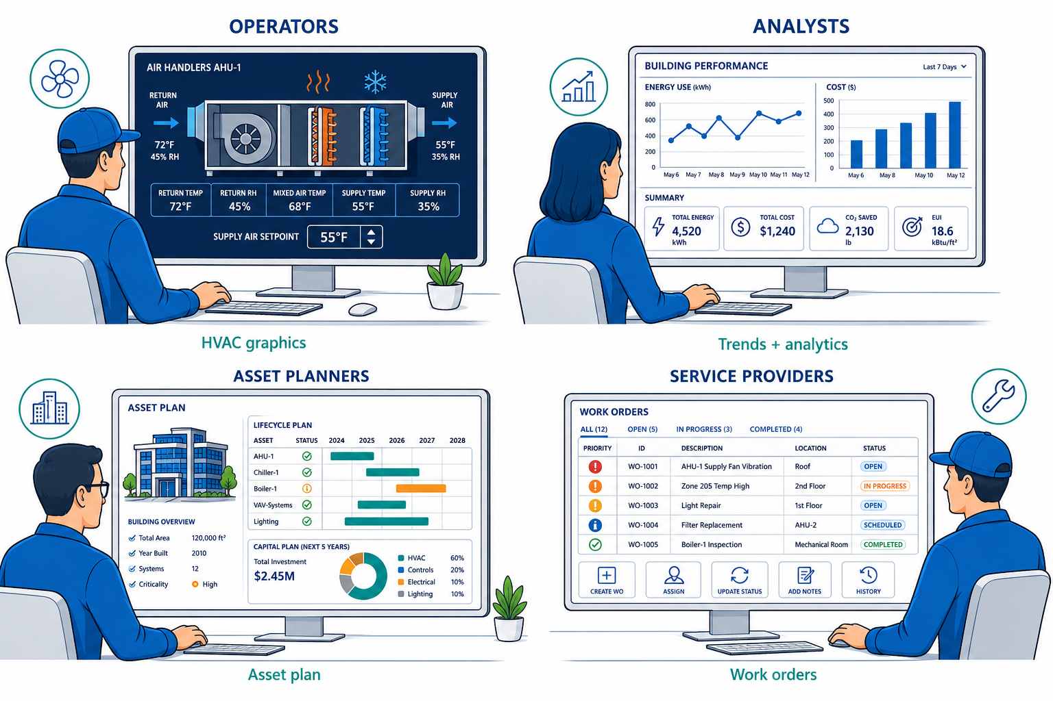
8 CREATE ROLE-BASED APPS & USER INTERFACES
PUT INFORMATION INTO ACTION
Give each role the information
and controls it needs.
C4SB INTEREST GROUP(S)
AI FOR BUILDINGS
Notes:
8. CREATE ROLE-BASED APPS & USER INTERFACES
Give each role the information and controls it needs.
Give each person the information—and controls—they actually need.
A digital building does not need one giant “digital twin dashboard.”
Different people interact with the same building for completely different reasons.
An operator may need an HVAC graphic with live temperatures, equipment status, alarms and authorized setpoints.
An energy analyst may need consumption, demand, trends and performance comparisons.
An asset planner may need equipment condition, lifecycle, replacement cost and capital forecasts.
A service provider may need diagnostics, work orders, maintenance history and access to the equipment they are responsible for.
An executive or owner may care primarily about cost, risk, resilience, asset value and performance.
The underlying building does not change.
The view changes according to the role and the question being asked.
Because the information comes from the Digital Building Profile and connected Graph of Graphs, applications no longer need to recreate an isolated model of the building every time we introduce a new use case.
The digital representation becomes shared infrastructure.
Illustrations are conceptual. Screen values and example addresses are illustrative, not observations from a specific facility.

Slide 12
Notes:
THE DIGITAL BUILDING IS NEVER “FINISHED”
Step 8 is not really the end.
Operations generate new information. Maintenance changes asset condition. Equipment gets replaced. Systems are upgraded. New applications appear. New questions emerge. Economics change.
That information feeds back into the Digital Building Profile.
And the cycle continues.
Identify → Gather → Profile → Value → Connect → Graph → Use → Operate → Learn
This is the fundamental shift.
We are not digitizing a building merely to answer the questions we know how to ask today.
We are creating an open, connected representation of what exists, how it relates, what it is doing, what it can do, what it costs and who is responsible for it.
That gives people, applications—and increasingly AI—the context necessary to answer questions we have not thought to ask yet.
And that is what turns an existing building into a digital building.
FOR MORE INFORMATION VISIT C4SB.ORG.

